Slide 1

USA_Housing
Predicting Target Variable.
Reflected Through Machine learning.
Renee’ Garrett

Slide 2
Agenda: Predicting Target Variable. +Reflect Through Machine learning
Data: ("USA_Housing.csv")
[5000 rows x 7 columns]
Avg. Area Income
&
Avg. Area Number of Bedrooms
Avg. Area House Age
&
PRICE
Avg. Area Number of Rooms
&
Area Population
&
ADDRESS

Slide 3
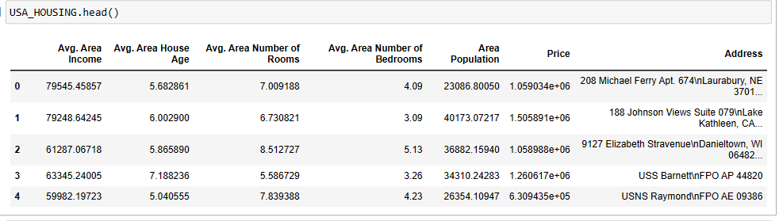
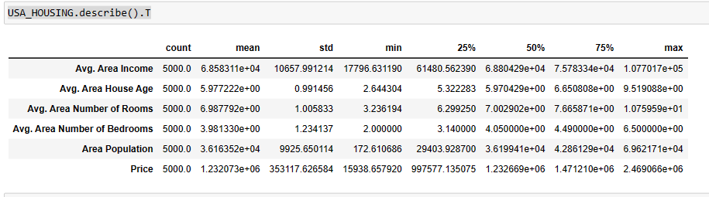
Problem Statement: Provide a visual and omit data not connected to predicting target variable!

Slide 4
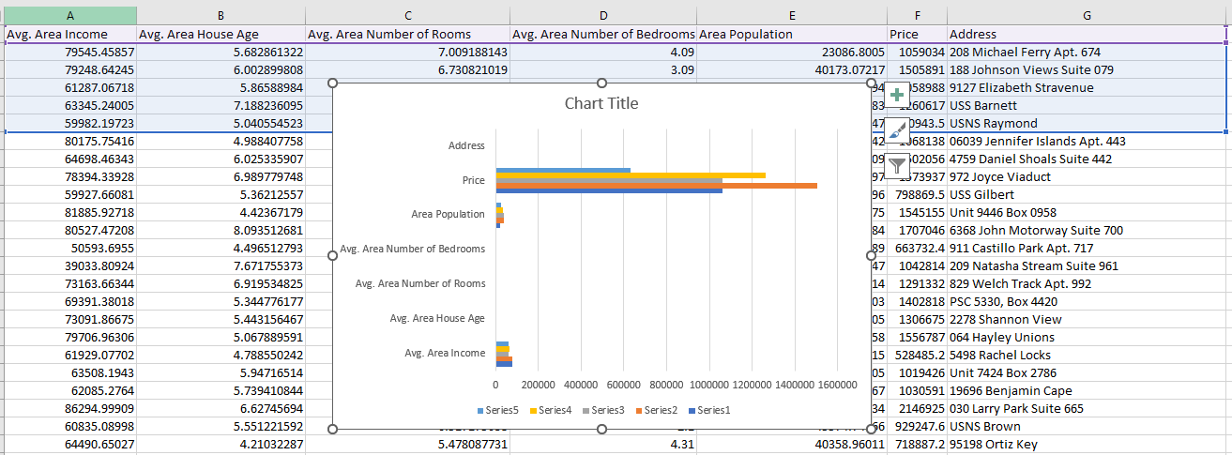
Dataset: USA_HOUSING = pd.read_csv("USA_Housing.csv")
USA Housing (kaggle.com)

Slide 5
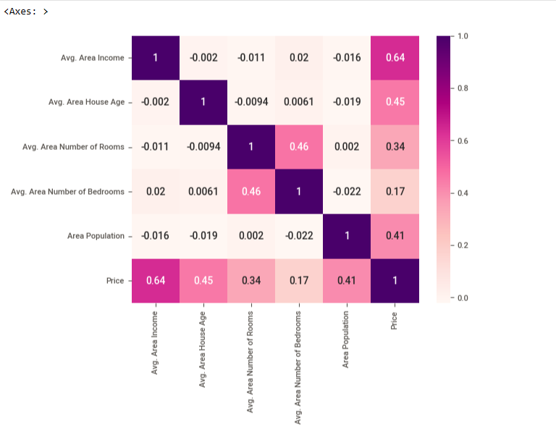
There are no null values. However, Address column, provides no assistance to other values. dropping address column.
Proceed to review columns;
'Price','Avg.Area Income','Avg. Area House Age’, 'Avg. Area Number of Rooms','Avg. Area Number of Bedrooms’, and 'Area Population’.

Slide 6
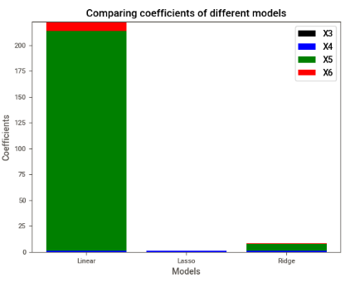
NOTE: Inspecting the coefficients, we notice Lasso and Ridge Regression had shrunk the coefficients, and thus the coefficients are close to zero. On the contrary, Linear Regression still has a substantial value of the coefficient for the X5 column.

Slide 7
Target Variable: Price
Based on the provided summary statistics, it seems "Price" variable is likely the target variable.
I have various features such as "Avg. Area Income," "Avg. Area House Age," etc., and the "Price”. Here's why "Price" is a candidate for the target variable:
1. Assumption: In a real estate or housing-related context, "Price" is often the variable of interest as it represents the value of the property.
2. Statistical Significance: The statistical summary provides descriptive statistics for all variables, and "Price" has characteristics consistent for a target variable, including a wide range of values.
3. Machine Learning Conclude: In a machine learning scenarios, the target variable is typically the variable you want your model to predict, and "Price" aligns with this role.
Unfortunately NO additional context or information to construct a valid problem. This was essential to confirm objective
Closing: Always ensure choice of data is a wide range for study.
Price:
Count: 5000
Mean: 1.232073e+06 (approximately 1,232,073)
Standard Deviation: 353117.626584
Minimum: 15938.657920
25th Percentile (Q1): 997577.135075
Median (50th Percentile or Q2): 1.232669e+06 (approximately 1,232,669)
75th Percentile (Q3): 1.471210e+06 (approximately 1,471,210)
Maximum: 2.469066e+06 (approximately 2,469,066)

Slide 8
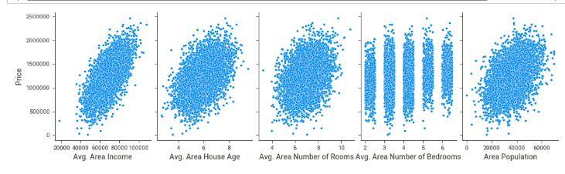
Q&a

Slide 9
Research:
USA Housing (kaggle.com)
https://www.analyticsvidhya.com/blog/2022/03/multiple-linear-regression-using-python/
https://www.analyticsvidhya.com/blog/2021/09/lasso-and-ridge-regularization-a-rescuer-from-overfitting/?utm_source=reading_list&utm_medium=https://www.analyticsvidhya.com/blog/2016/01/ridge-lasso-regression-python-complete-tutorial/

